Slide 1


My body

Slide 2


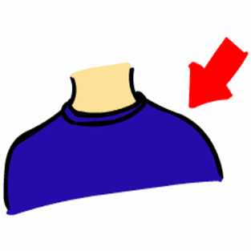



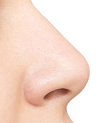

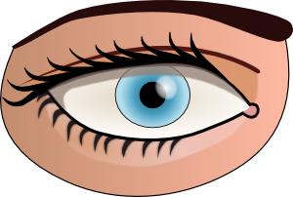

Listen, point and say

Slide 3


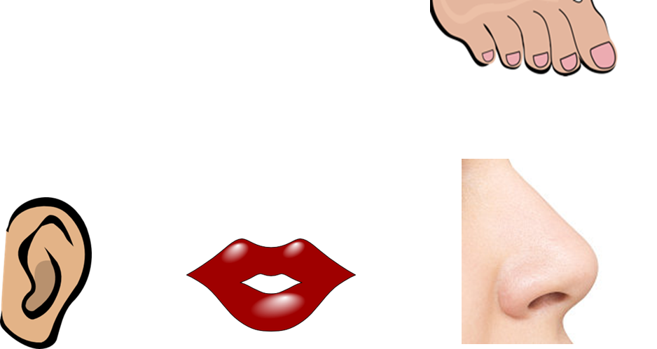

What’s missing?

Slide 4


Slide 5
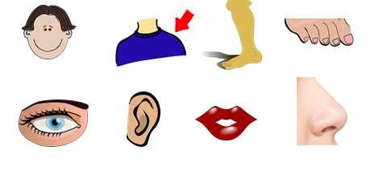

Slide 6
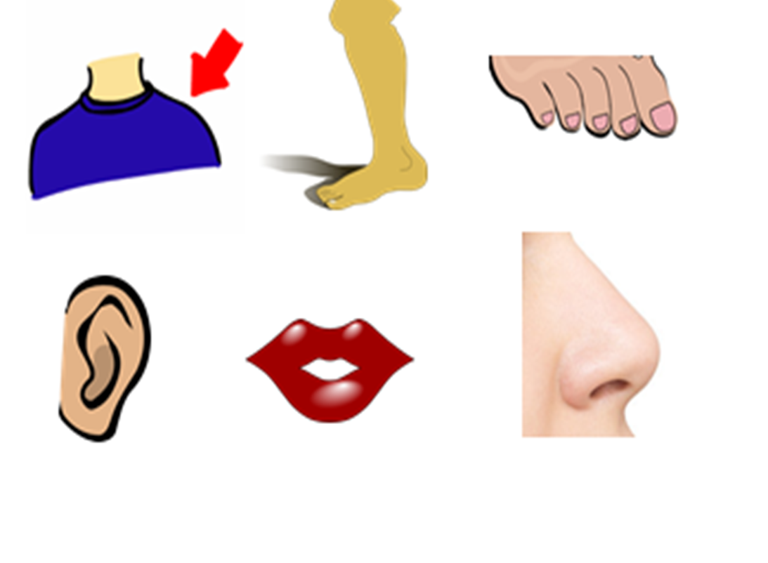
What’s missing?

Slide 8
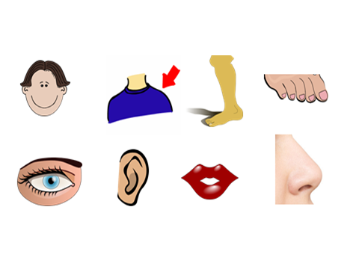

Slide 9
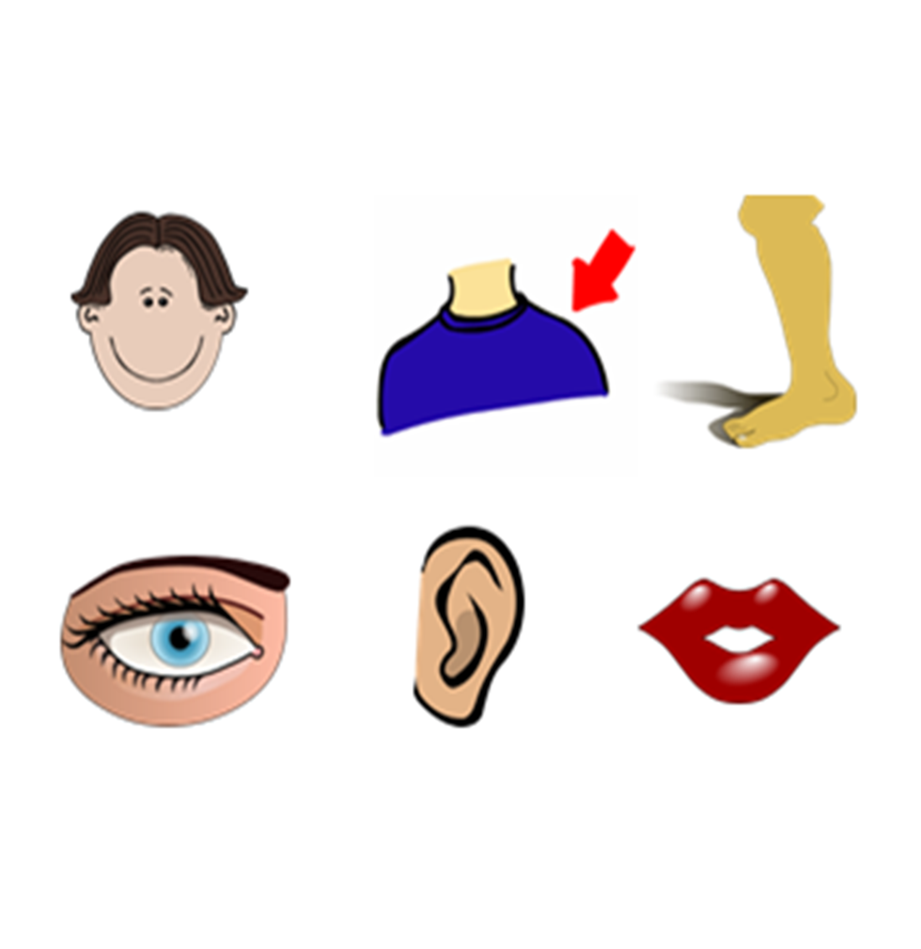

What’s missing?

Slide 10


Slide 11


Slide 12

What’s missing?

Slide 15

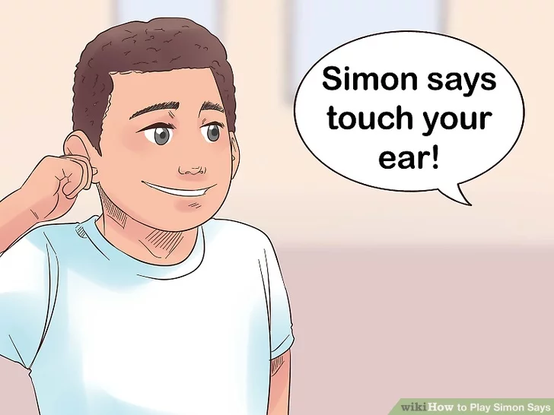
Let’s play ‘’Simon says…’’

Slide 16

Let’s play a memory game!
http://www.quia.com/jg/3117194.html

Slide 17
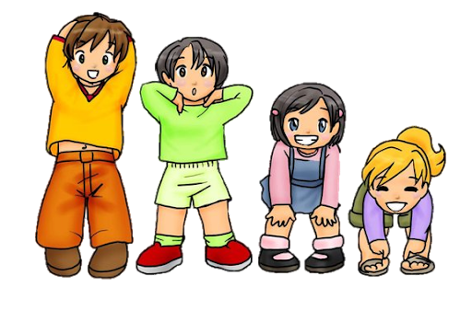

Let’s sing ‘’Head and shoulders, knees and toes!”
https://www.youtube.com/watch?v=ZanHgPprl-0

Slide 18

Creative exercise

Slide 19

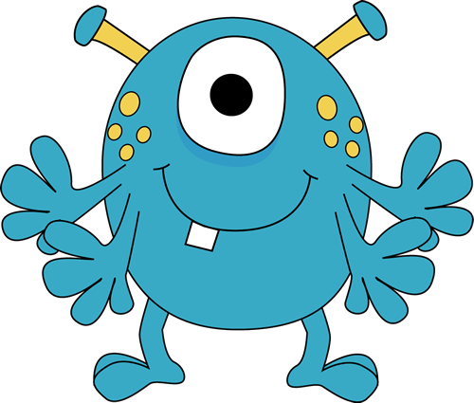
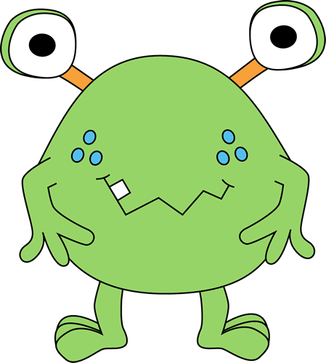
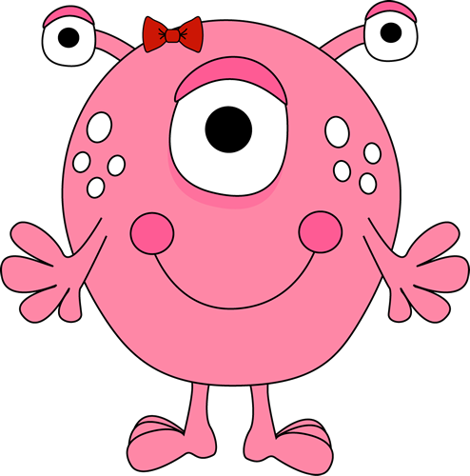
Listen and click on the right monster.

Slide 20


Slide 21


Slide 22


Well done!

Slide 23

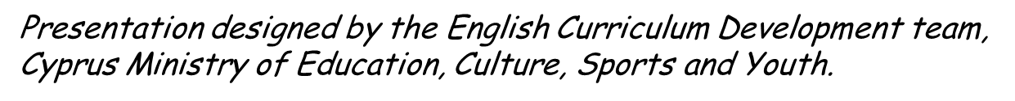
http://www.clker.com
https://images.app.goo.gl/rdPYg7tRaJNjFsMg7
https://images.app.goo.gl/8Bfx5i28yNBJR3s18

